Slide 1
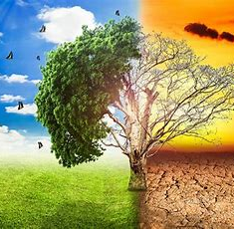
Climate change
Created by Ieda Seifi

Slide 2

What is climate change?
Climate change refers to long-term changes in temperatures and weather patterns. These shifts may be natural, such as through variations in the solar cycle. Or it can be due to human activities, such as burning fossil fuels like coal, oil, and gas.

Slide 3
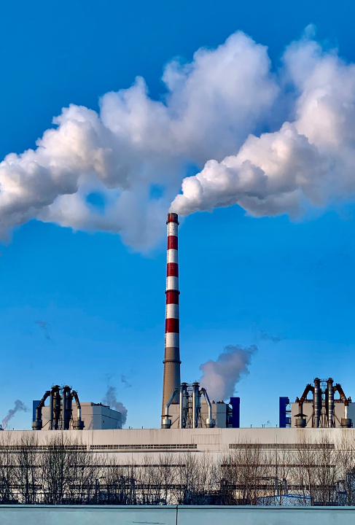
Burning fossil fuels generates greenhouse gas emissions around the Earth, trapping the sun´s heat and increasing temperatures. carbon dioxide and methane are example of greenhouse gas emissions that are causing climate change.
These come from using gasoline for driving a car or coal for heating a building, for example. Landfills for trash are a significant source of methane emissions. Energy, industry, transport, buildings, agriculture, and land use are among the main emitters.

Slide 4
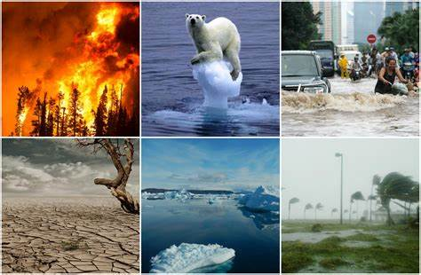

Slide 5
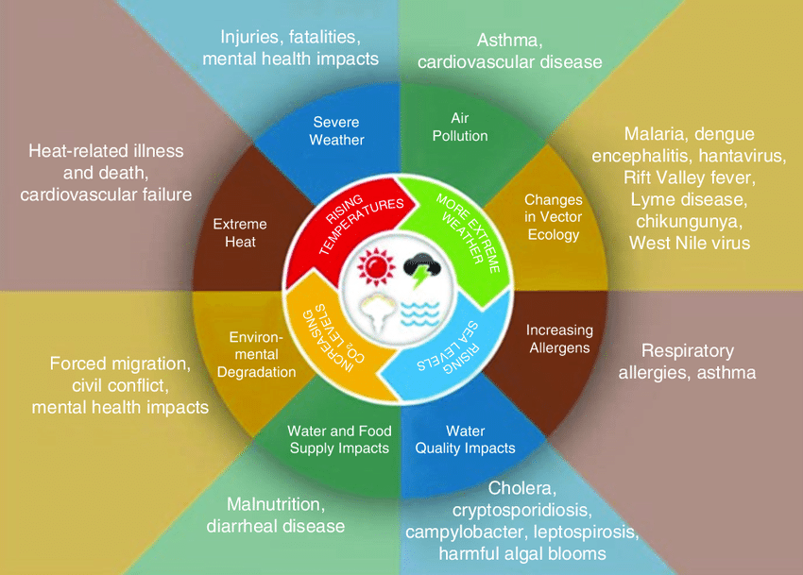

Slide 6

Solutions
*Switch to sustainable transport
*Invest in renewable energy
*Protect forests like the Amazon
*Protect the oceans
*Reduce how much people consume
*Reducing plastic consumption
*Invest in renewable energy.

Slide 7
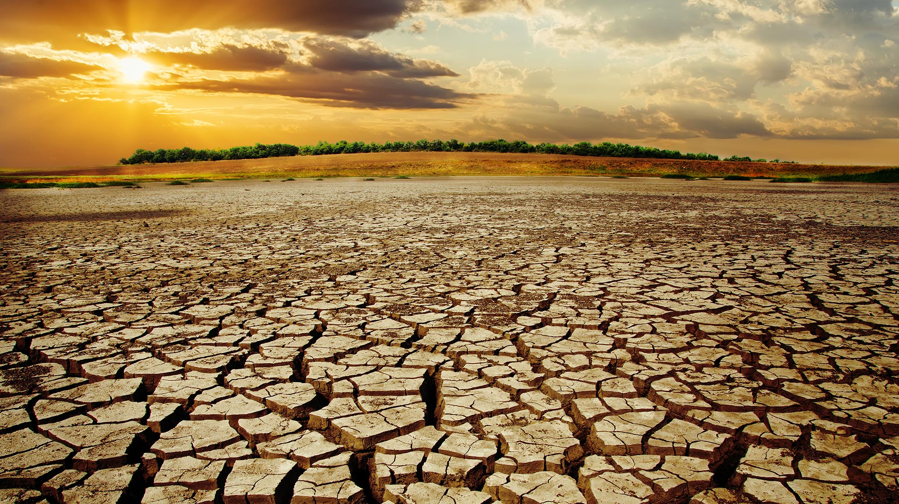
waste of energy and burning fossil fuels cause global warming and it has dangerous effects on the life of humans, animals, and plants. The best solution is reducing the use of fossil fuel or even an alternative to it. for example instead of using diesel cars, we can use electric cars.

Slide 8

Thank you for your attention

